Slide 1
Global Health Analysis: Visualizing Life Expectancy and Key Health Indicators and Making Future Forecasts
PROJECT TYPE : ANALYTICS ENGINEERING

Slide 2
PROJECT OVERVIEW
This project aims to analyze various health indicators (HIV/AIDS & Hepatitis B) across different countries using Power BI. The analysis includes comparison analysis, trend analysis, demographic analysis, and forecasting. The primary goal is to provide insights into the health status of different countries and predict future health trends.

Slide 3
MY ROLE
Researched and obtained data
Cleaned data
Analyzed and Visualized Data
Organized my Github repository
Prepared my Presentation Slides

Slide 4
TECHNICAL CHALLENGES
Demographics was not available in data set for Demographic Analysis
Forecasting feature could only be used for charts/graphs with two parameters which limited some analysis needed to be made
Creating meaningful and clear visualizations that effectively convey insights.

Slide 5
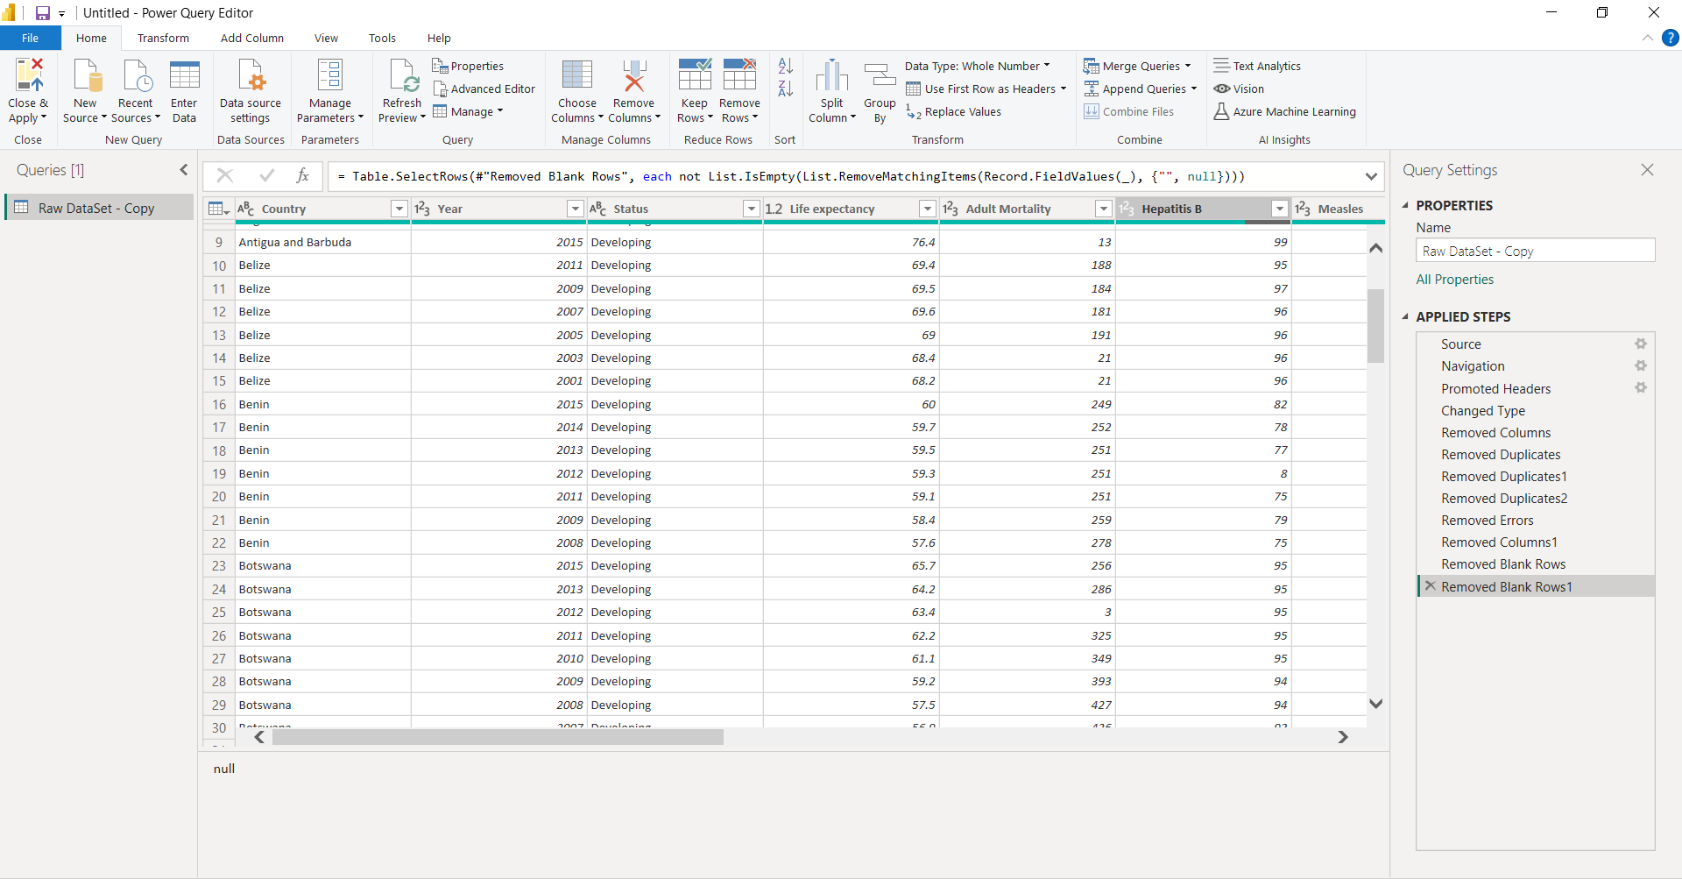
SOLUTION APPROACH
Data Preparation/Cleaning
Obtained Data from Kaggle
Cleaned Data Using Power Editor Query

Slide 6
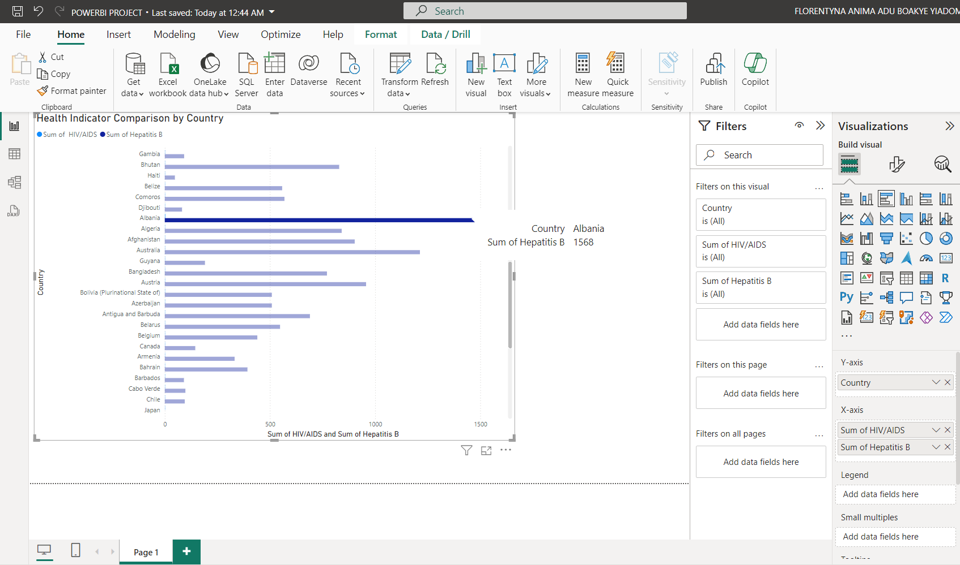
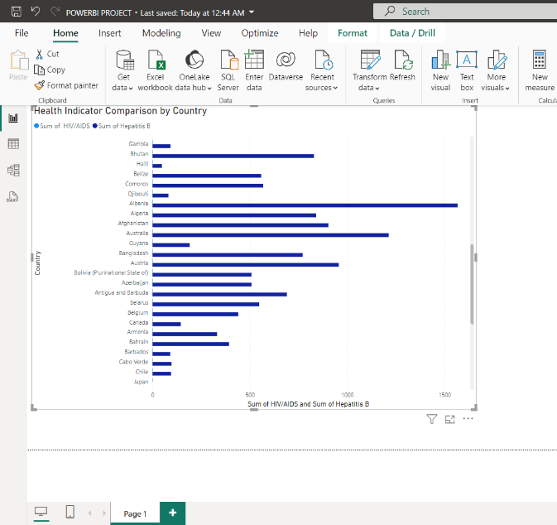
SOLUTION APPROACH 1. Comparison Analysis
Bar Chart

Slide 7
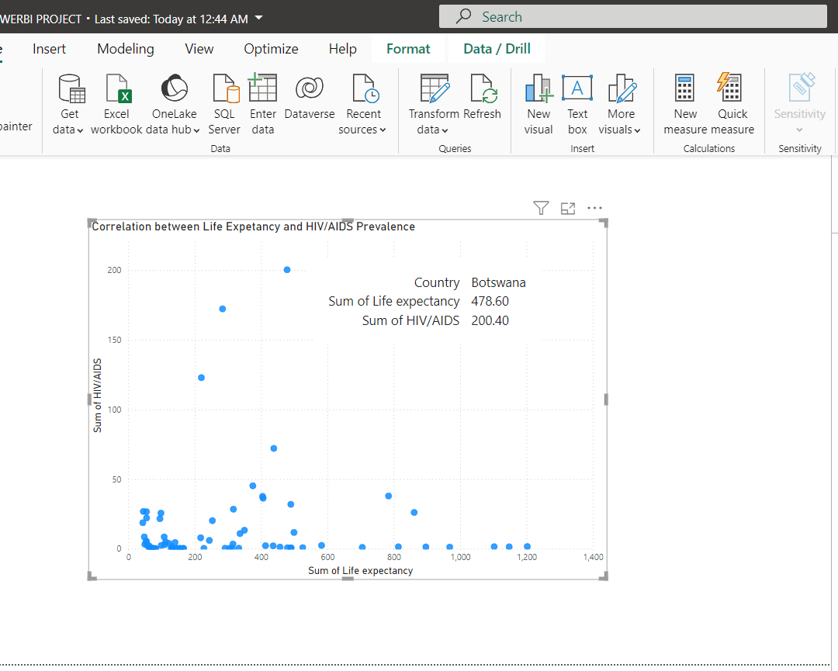
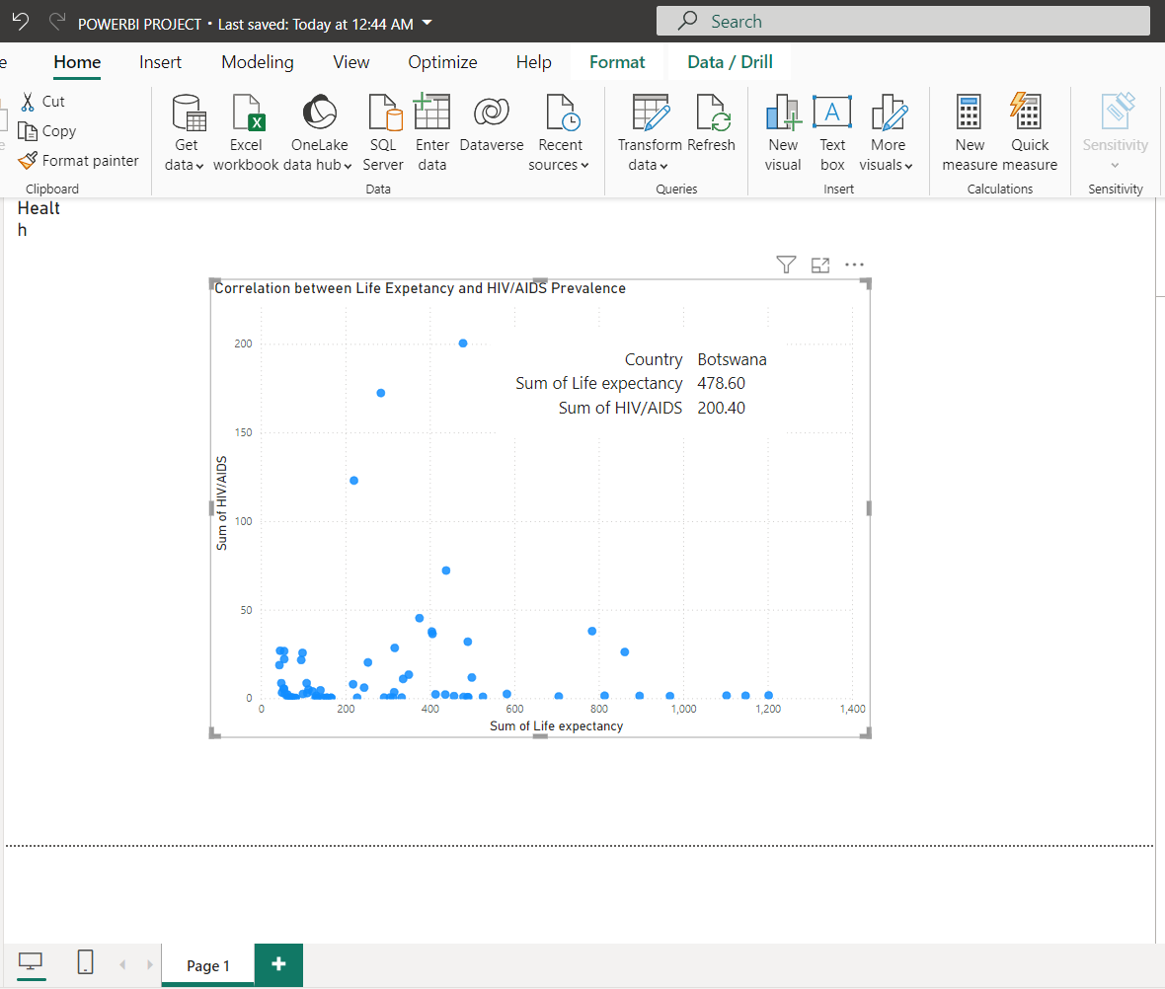
SOLUTION APPROACH 1. Comparison Analysis
Scatter Chart

Slide 8
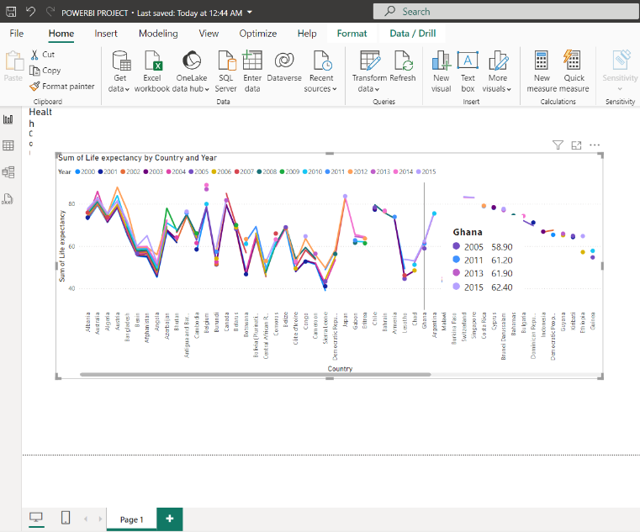
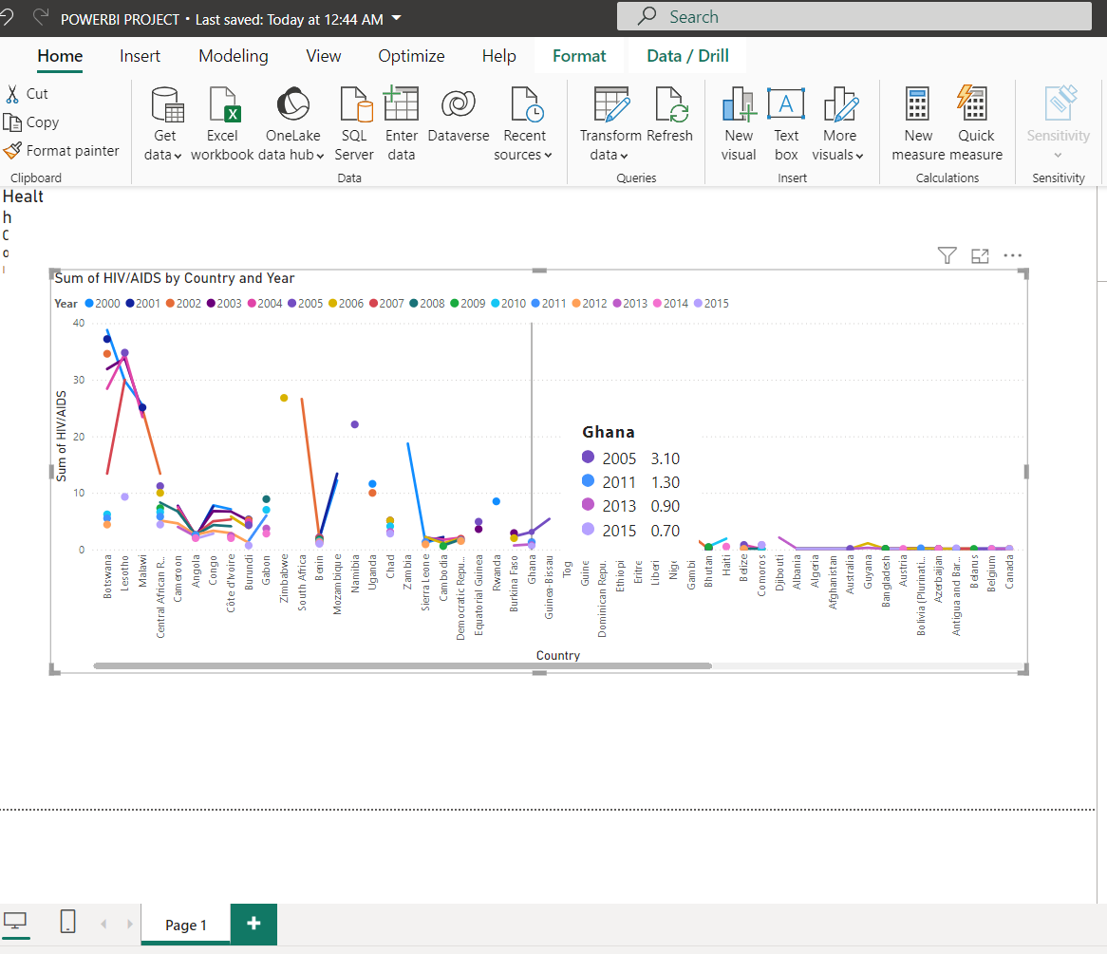
SOLUTION APPROACH 2. Trend Analysis
Line Chart

Slide 9
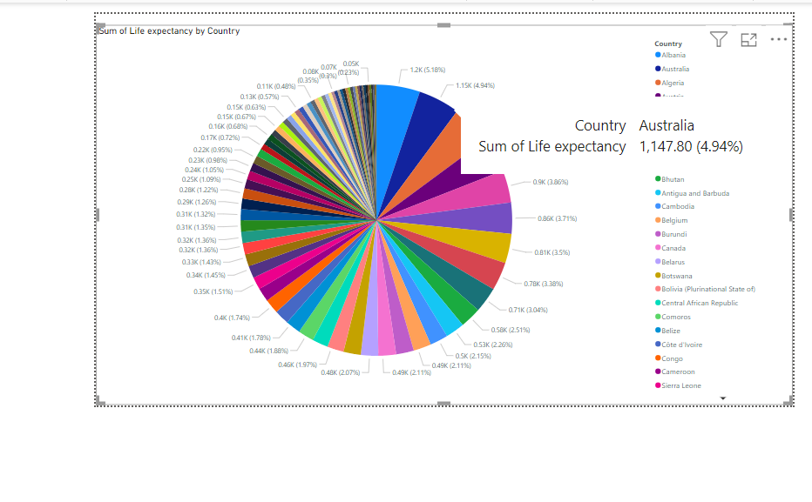
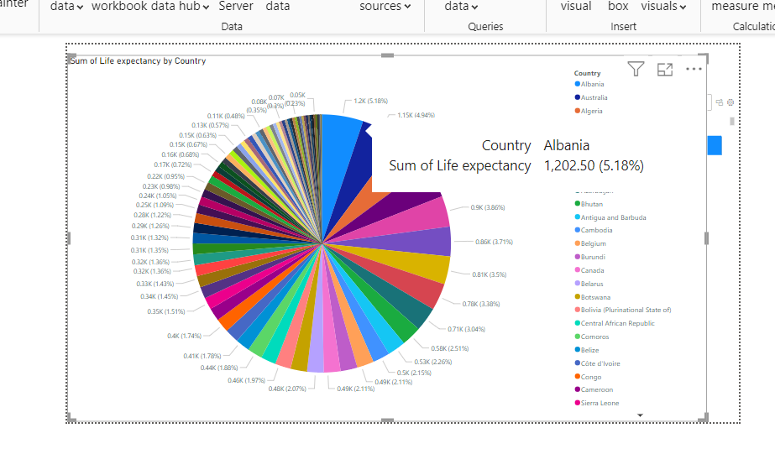
SOLUTION APPROACH 3. Demographic Analysis
Pie Chart

Slide 10
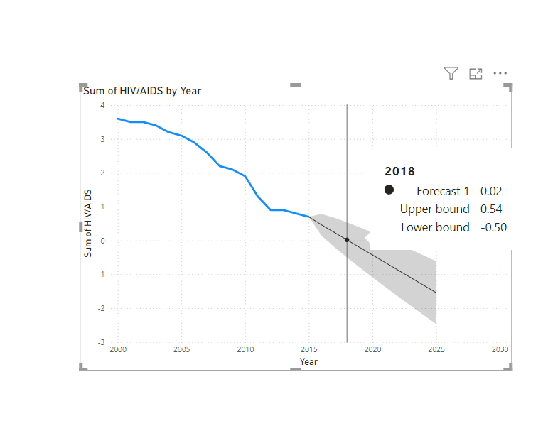
FORECAST

Slide 11
LESSONS LEARNED
Data Quality: Importance of data cleaning and preparation for accurate analysis.
Visualization Techniques: Effective use of Power BI features to create meaningful visualizations.
Analytical Skills: Enhanced ability to analyze and interpret health data trends.
Project Management: Improved skills in managing end-to-end data projects.

Slide 12
RESULTS/IMPACT
Trends Identified: Visualized trends in life expectancy and key health indicators over time.
Correlations Found: Identified correlations between life expectancy and other health indicators like HIV/AIDS.
Public Health Insights: Provided valuable insights for policymakers and public health officials to address health issues.

Slide 13
ADAPTABILITY
Data Source Flexibility: Ability to adapt to different data sources and formats.
Project Scope Changes: Managed changes in project scope and requirements effectively.

Slide 14
TECHNOLOGICAL TOOLS USED
Power BI: For data cleaning,visualization and analysis.
Excel: For viewing raw data
GitHub: Repository for project documentation

Slide 15
CONCLUSION
Data Engineering Skills: Demonstrated strong skills in data collection, cleaning, visualization, and analysis(POWERBI)
Problem-Solving: Effectively addressed technical challenges and provided innovative solutions.
Impactful Insights: Delivered valuable insights to inform public health strategies.

Slide 16
PRESENTATION DATE
Presentation Date : 20th June 2024
Time :7PM-7:15PM
Github Link: https://github.com/FlorentynaAnima/Data-Engineering-Project-Work.git

